Slide 1


Quality Assurance/Quality Control (QA/QC) Processes developed for W.A.D.F. Temperature Data
Natasha Neumann & Brandon Ming
BC Ministry of Forests, Lands, Natural Resource operations and rural development
Kootenay boundary region
September 2020
Natasha.Neumann@gov.bc.ca
Notes:
Natasha

Slide 2
overview
Automated
Manual
Daily air temperature dataset
Pre-screen
Remove obviously bad values (e.g. 6999, -99999, etc).
Limits test – flag values more than 2 standard deviations different from station mean
Rate of change test – flag values that change dramatically from one day to the next
No change test – flag values when there is little change over 3 days
Flag zeroes
Introduction
Step1
Initial review tests
Step2
Differences Between Hourly and Daily Data
Step3
Gap filling
Conclusion
Step 1 – Initial review of the mean, min and max data
Manual review of flagged data. Delete data as appropriate and document.
Step 2 - Assess statistical validity of daily mean
For each day, count number of missing values in the hourly dataset.
For each day, compare the daily mean value with the mean calculated from the hourly data
Manual review of flagged data. Delete data as appropriate and document.
Fill gaps using redundant sensors at the same station.
Fills gaps using data from adjacent stations based on lapse rates.
Step 3 – Gap filling
Notes:
Natasha

Slide 3
Introduction
Purpose: To clean daily and hourly temperature records from West Arm Demonstration Forest climate network (8 stations, 1992-present).
Delete bad data and fill gaps which may occur because of:
Instrument drift, power failure, programming error, station changes, etc.
R code used to quickly flag potentially bad data.
Flags then manually reviewed and data points deleted based on expert experience.
Notes:
Natasha

Slide 4
Step 1 – pre-screen and Initial review
Automated
Daily air temperature dataset
Manual
Pre-screen
Remove obviously bad values (e.g. 6999, -9999, etc).
Limits test – flag values more than 2 standard deviations different from station mean
Rate of change test – flag values that change dramatically from one day to the next
No change test – flag values when there is little change over 3 days
Flag zeroes
Step 1 – Initial review of the mean, min and max data
Manual review of flagged data. Delete data as appropriate and document.
Notes:
Brandon
Firstly, we will review how the Step1 works.
For the Step1 we are focusing on the Daily dataset. Then we do the pre-screen of the dataset. If we see any obviously bad values, we will set the values manually and let the script helps us to clean the bad values automatically.
Then there are 4 test will apply for the step1. (then introduce the 4 test)
After that, the result should be manually reviewed by the user.

Slide 5
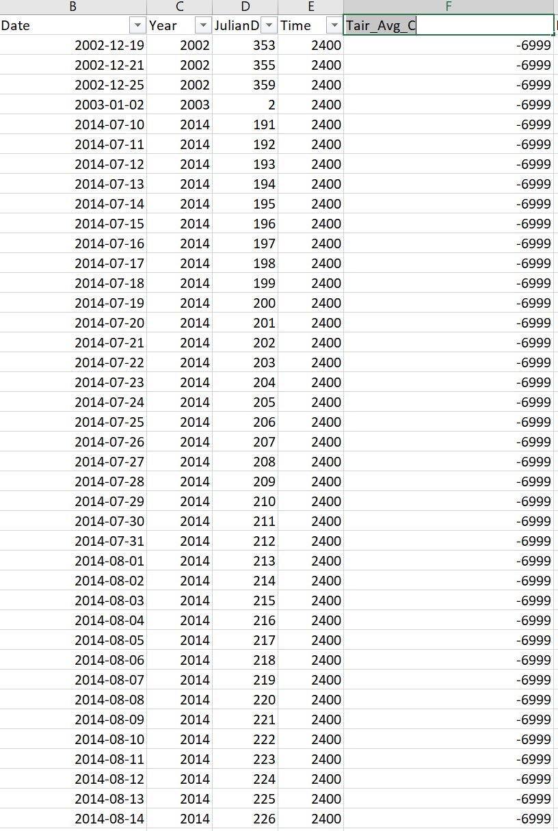
Pre-screening
R code deletes obvious errors.
Due to programming errors, sensor failure, wiring problems.
Values set manually based on quick manual review.
E.g. -6999
Notes:
Brandon
As we can see from here, there are lots of -6999 values, then we set the values on the script then the script will help us to delete them.

Slide 6
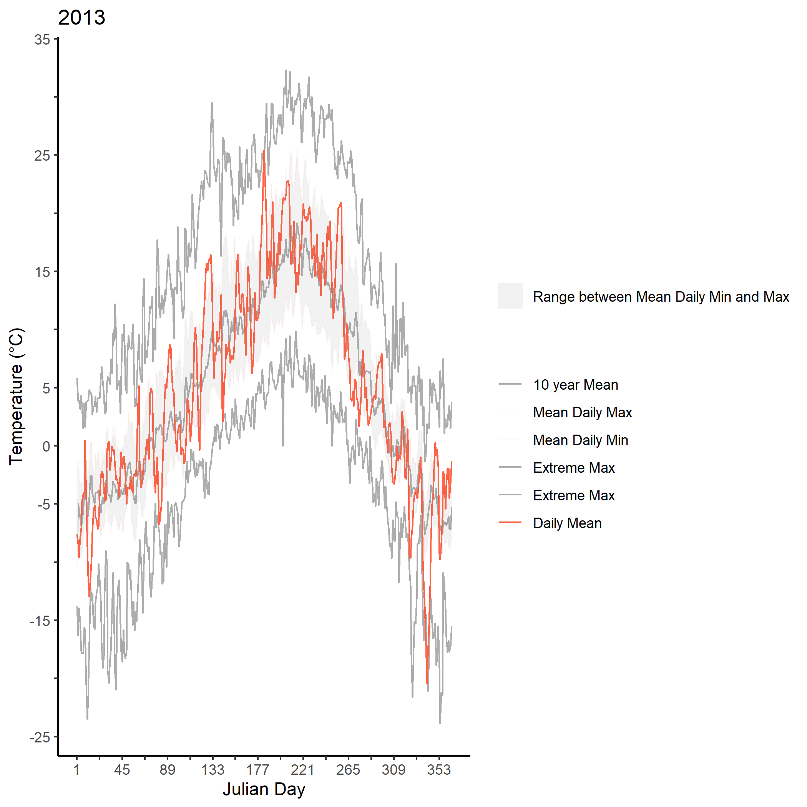
1. Limits Test
Tests if daily mean, min and max values fall within a reasonable range.
Algorithm:
For each day of the year, use the first 10 years of data to calculate the average and standard deviation for daily mean, maximum and minimum.
Flag data that do not fall within 2 standard deviations of the average.
Could also use data from another station
Notes:
Brandon
As for the limited test
The reason for using this: we are trying to make a reasonable range for the temperature in order to find which day has some suspect values.
Algorithm
Plots is helping to see whether there is a bad(suspect) data there or not, there are 10 years mean( in the future will be the whole dataset) , Mean daily Max/Min is using the mean of Max/Min, extreme max = max of max/ min of min for that julianday.
The gray range is between mean dialy max /min. If the temperature are out of the bound, it can be treated potentially suspect.

Slide 7
2. Rate of Change Test
Using other data (e.g. Environment Canada stations) to assess if the change in temperature from one day to the next is reasonable (identify spikes).
Algorithm:
Calculate the difference between two consecutive values. If the difference is larger than expected, data is flagged.
For the WADF stations, derived max expected daily change from Castlegar climate station (1992 to 2019).
Notes:
Brandon
This method is using for the situation that some days have a uncommon changes between two consecutive day.
Algorithm.

Slide 8
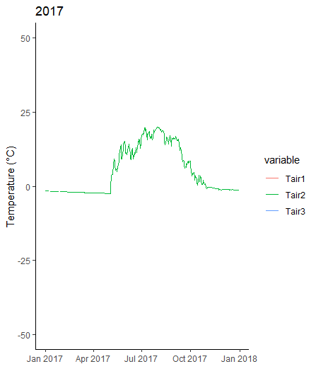
3. No Change Test
Identify when mean temperature changes less than 0.1°C over 2 or more days.
Causes: Sensor malfunction, programming errors.
Notes:
Brandon
This is using for the technical issues for the sensors or some errors with the sensors.
Algorithm:

Slide 9
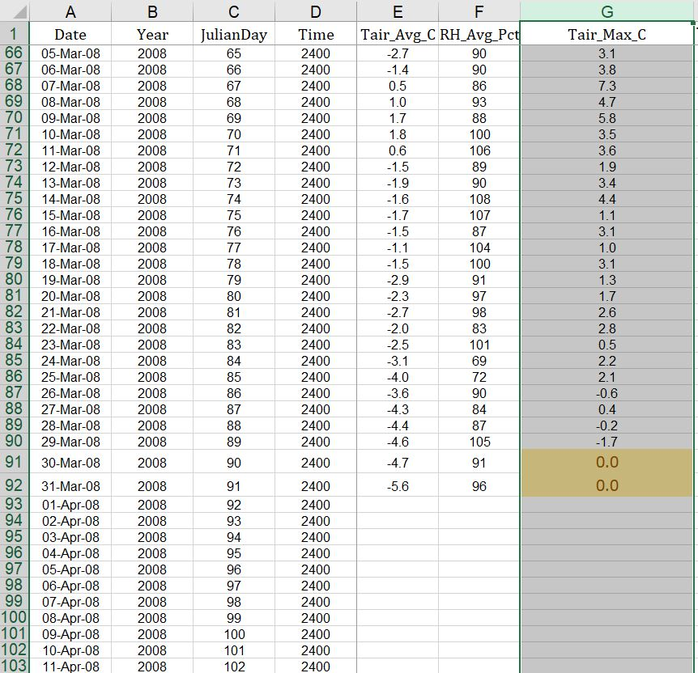
4. Zeros for Min and Max
Zeros for Min and Max temperatures can result when loggers are reset due to program changes or power problems.
Flag zero values for review.
Notes:
Brandon
This method are detecting a very suspected situation that the Min/Max of a day are 0 degree.
As can see from the graph.

Slide 10
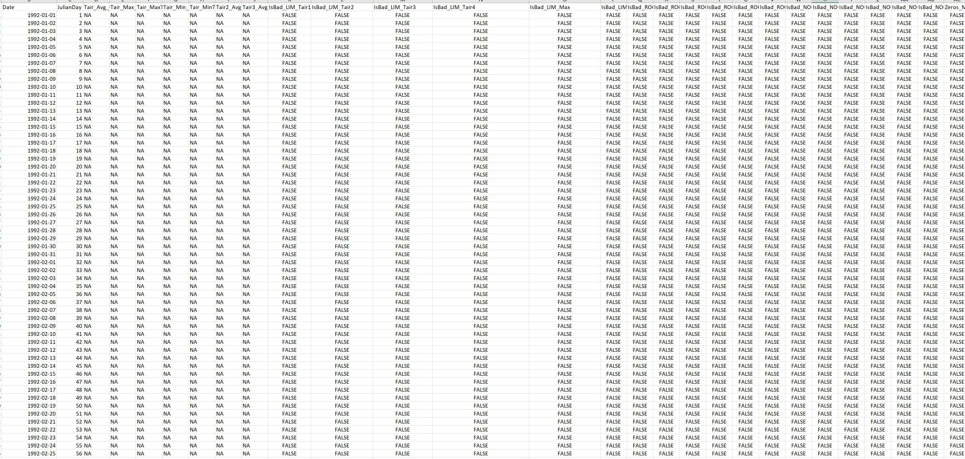
Step 1 Manual Review
R code outputs CSV file with original data and flags.
Expert reviews flags and deletes bad data.
Notes:
Brandon
So here is the example of the output, as can see there are flags for the different test for different sensor.
The user will go through the flag == True to see whether it is a good data or bad data.

Slide 11
Step 1 QA/QC Efficiency: Burn station
10221 days assessed
Limits Test: <1%
Rate of Change Test: 0%
No Change Test: 92%
Notes:
Brandon
Explain what the graphs represent.
As we can see the most efficiency test will be the Non of change test

Slide 12
Step 2 ‘statistical’ tests
Automated
Manual
Results from Step 1
For each day, count number of missing values in the hourly dataset.
For each day, compare the daily mean value with the mean calculated from the hourly data
Uses daily and hourly data.
Is the daily mean representative?
If the daily and hourly means are more than 0.1°C different, it may indicate power problems, site visits, program changes or errors copying the raw data into spreadsheets.
Manual review of flagged data. Delete data as appropriate and document.
Notes:
Brandon
Step2 are combined Daily data and hourly data.
There are two test for the step2,
Detecting how many hours are missing for a day, if there are more then 3 hours are missing, that daily mean are may not believeable.
Detecting the hourly data mean for a day and compare to the daily data.

Slide 13
Step 2 QA/QC Efficiency: Burn station
Most of the days flagged were already NA in the dataset, so review was efficient
Notes:
Brandon
The efficiency of the step2 test.

Slide 14
Step 3 gap-filling (optional)
Automated
Manual
Results from Step 2
Fill gaps using redundant sensors at the same station.
Fills gaps using data from adjacent stations based on lapse rates.
Gap-filling (where appropriate)
Compare multiple sensors at the same location.
May require correction for different sensor heights, sensor types or calibration drift.
Compare to ‘nearby’ stations.
Correct using lapse rates (effect of elevation)
Notes:
Brandon
The step3 are more about the compare sensors in same station, this steps will use for the future gap-filling algorithm.
The step3 will also using the comparison to form the gaps using near by stations.

Slide 15
summary of deleted data (steps 1 and 2)
Notes:
Only show one of the legends.
Brandon
This is the how many days are deleted for each sensor by each test
Demonstrates the need for different tests.

Slide 16
Conclusions
Flags from some of the tests are uncommon but all are important.
E.g. No change test
Automated flagging using R is efficient.
Easy to run as new data collected.
Manual review steps are very important.
Expert opinion always trumps statistics-based assessment.
Data is ‘clean’ and publishable after Step 2; gap-filling is value-added.
R code and supporting documentation available
Modifications for use with other datasets doesn’t require extensive R experience
Notes:
Natasha

